Slide 1

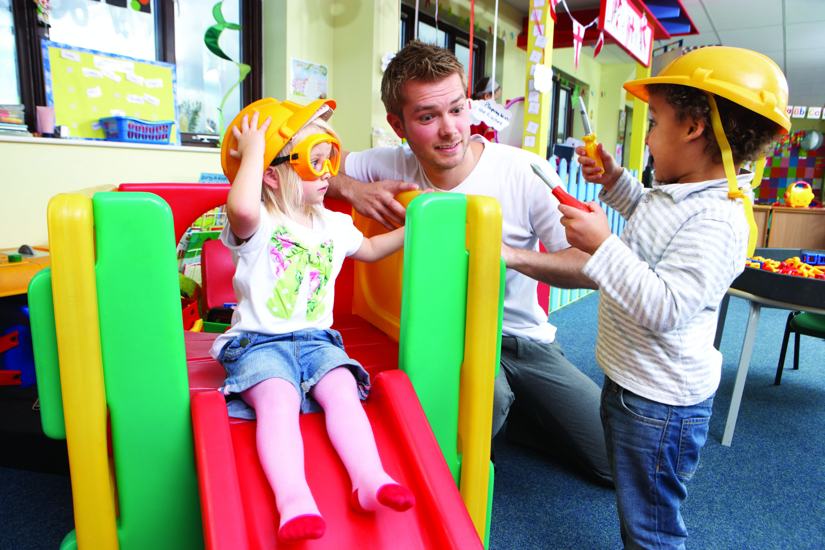


Responsive, Caring Relationships
In Early Learning and Child Care Settings, Module 2

Slide 2
Purpose of these Learning Modules
Responsive, Caring Relationships is part of a series of training modules for supply and non-ECE staff working in Early Learning and Care in Peterborough City and County. Training for these important staff has been identified as a priority in our community.
Along with Responsive, Caring Relationships, this online series also consists of three additional modules on the following topics:
How Does Learning Happen?
Child Led Approaches to Learning
Child Development

Slide 3












LEGEND
Throughout this presentation you will find symbols to indicate how to engage with the material.
Click the link to read the required material
Click the link provided to watch the video
Reflect on the reading or video materials and take notes about your reflections to share with your supervisor

Slide 4

Agenda
Cultivating Authentic Relationships –Connecting to How Does Learning Happen? HDLH Document
Understanding and Responding to Children’s Cues
Understanding Children’s Stress and Self-Regulation
Tips for Setting Respectful Limits
Where to go for help…Resources
Take time to write your thoughts and responses to some of the questions. This will help you understand the material better.
Along with these slides, you will find links for articles to read and videos to watch.

Slide 5

Cultivating Authentic Relationships and Connections
How Does Learning Happen?, Ontario’s Pedagogy for the Early Years states that:
“Young children experience their world as an environment of relationships which affect virtually all aspects of their development.”
“Every child has a sense of belonging when he or she is connected to others and contributes to their world.”
“Early childhood programs cultivate authentic, caring relationships and connections.”
HDLH pg. 24

Slide 6

Connections are Key
“Research demonstrates that positive, caring, and respectful relationships are the foundations for optimal learning, development, health and well-being”. HDLH? pg. 24
Reflect:
Take a moment to think about the following questions:
What does a positive, caring and respectful relationship mean to you?
What do you see, hear, feel?
In what ways do you see authentic relationships contributing to healthy child development (social-emotional-physical-cognitive-language)?

Slide 7
Building Connections
Read: The Power of Positive Adult-Child Relationships: Connection is the Key by Dr. Jean Clinton The Power of Positive Relationships
Reflect:
Think about an adult who was important in your life as a child. How did they build connections with you?
How did their efforts to connect with you strengthen your relationship with them?
Watch: the following video that discusses the role of connection vs correction and direction
Brain Development in the Early Years – Connecting with Children vs. Directing their Behavior - YouTube
How does this same concept transfer to your daily practice with children?

Slide 8

Making Connections
How can we build connections with children?
Welcome each child everyday
Be at child’s level/ face to face/ eye contact
Use a pleasant, calm voice and provide warm physical contact when appropriate
Follow the child’s lead and engage in their play when appropriate
Provide simple and clear expectations (“It’s time to put your boots on.”)
Engage children in the process of resolving problems and conflicts
Listen to children
Be genuine in acknowledging children
The Power of Positive Adult-Child Relationships: Connection is the Key, Dr. Jean Clinton pg. 4

Slide 9

Responding Sensitively to Children’s Cues Builds Trust
An important part of building positive caring relationships is understanding children’s cues. Many of the infants and children we work with do not have language or the ability to express their needs verbally and use physical cues to indicate their needs. Some of these cues might be:
    Crying
    Temper Tantrums (throwing self on the floor, biting)
    Yawning
    Disengaging (looking or pulling away from others)
    Pointing, grunting
    Yelling
These behaviours are a form of communication. They need to be responded to in a caring manner. There is a reason for this communication, and it is our job to understand their cues.

Slide 10

Dispelling Myths
Some people believe that if you respond to an infant or young child every time they cry or have a tantrum, they will become spoiled or misbehave.
Brain research has demonstrated that when we respond to children when they cry or show other stress cues, we are helping them to learn how to deal with stress. Eventually they will learn to soothe themselves on their own after we have modeled this over time. In the beginning, they need us to help them co-regulate.
Children who are comforted learn to trust themselves and others.
When we respond to children’s stress cues, we are helping them to regulate their emotions and learn how to manage stress in a positive manner.

Slide 11
Responding to Cues: It is important that we respond to these cues in a positive manner.
Start by calming yourself first.
Stay close by when children are overwhelmed
Pick up the child and comfort them if they will allow
For older children-stay close by, rub their back, put a gentle hand on their shoulder if they will allow
Get down to the child’s level and make eye contact, using a calm voice
State what you are noticing… “You sound very sad right now”.
Meet their physical needs (hunger, thirst, sleepiness)
Respond to cues in a consistent manner
What are some other ways you respond to children’s cues in a positive manner?

Slide 12

Understanding Cues
Sometimes reading and understanding children’s cues feels like detective work.
Every child has individual cues and behaviours that you will begin to understand and be better able to anticipate and respond to as you get to know them.
Cues/behaviours are a message of stress which is causing a child discomfort (physical or emotional).
Stress cues that are unmet make it difficult for children to cope.
To help us understand children’s stress cues we will explore the work of Dr. Stuart Shanker from the MEHRIT Centre on Self-Regulation.

Slide 13
Attachment
Learning to understand a child’s cues and responding to them consistently in a caring manner helps to build attachment. Strong bonds between a care provider and a child supports the child’s social and emotional development. Healthy attachments set the foundation for children to learn to self regulate which we will talk about in the next slide but first click the link below to read the article about attachment theory and how this is important in both family and care provider relationships.
A Brief Overview of Attachment Theory and Importance

Slide 14

Self-Regulation… What is it?
Let’s watch the following video by Dr. Stuart Shanker to better understand this topic.
Self-Regulation
Self-regulation is understanding brain-body stress and managing energy and tension.
Children, especially infants and toddlers, need adults to help them co-regulate because they cannot always regulate themselves.
Self-regulation is not the same thing as self-control. Self-control assumes we have control over our emotions and actions.
Self-regulation skills can be modelled and taught. It takes time to learn these skills.

Slide 15
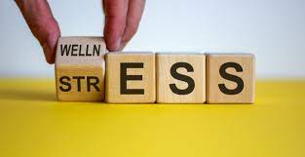
Reflect:
1. How do you recognize brain-body stress in yourself?
2. What do you feel?
3. How do you manage your own energy and tension?
4. What strategies do you have in place?
Did you find answering these questions difficult? We first need to understand our own stressors and how we manage them before we can help children understand and learn strategies.

Slide 16

Why is Self-Regulation Important to Understand?
Children are not born with the ability to self-regulate and manage stress. They need our help to learn these skills. They need us to co-regulate.
Children’s inability to self-regulate can be mistaken for misbehaviour and therefore our response to the behaviour may be inappropriate.
Our response to children’s behaviours is key in building healthy brains and relationships
All behaviour is communication.
Let’s now look at some brain physiology to understand self-regulation…

Slide 17
Understanding Brain Physiology
BLUE BRAIN
The neocortex is our thinking brain. Dr. Stuart Shanker calls this blue brain.
It is the last part of our brain to develop (25 years of age).
Our best learning takes place when we are using this part of the brain.
When children are in this state, they are calm, alert and ready for learning.
RED BRAIN
The reptilian brain is the area of our brain that is built for survival. It helps us to anticipate and react to threats. Dr. Stuart Shanker calls this our red brain.
This is the part of the brain we use when we are overloaded with stress. It regulates our heart rate, blood pressure, etc.
We cannot think logically when we go into a red brain state, and children often need our help to become calm again.

Slide 18
What Happens When We are in Red Brain State?
When we are in ‘red brain state’, digestion gets turned off; immune system diminishes, muscles in middle ears change, cortisol (stress hormone) goes up, blue brain (thinking brain) gets turned off.
We go into one of four states:
Flight-we flee the stress/danger Fright-we become hyper aware and anxious
Freeze-we become immobile Fawn-please and appease
Reflect:
Think about a time you have reacted to a stressful situation in one of these ways?
What was helpful to you when friends, family, co-workers responded to your stress?
Have you seen children who have reacted to a stressful situation in one of these ways?

Slide 19
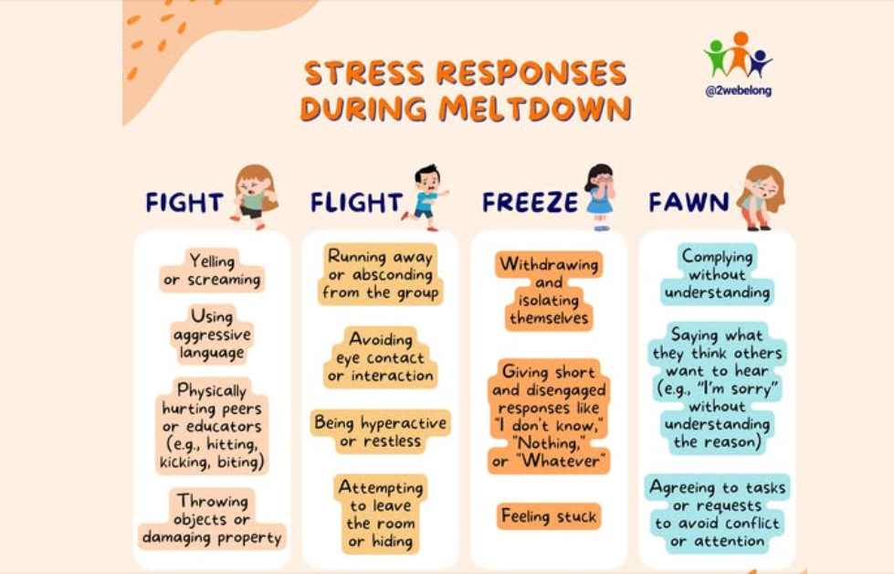

Slide 20
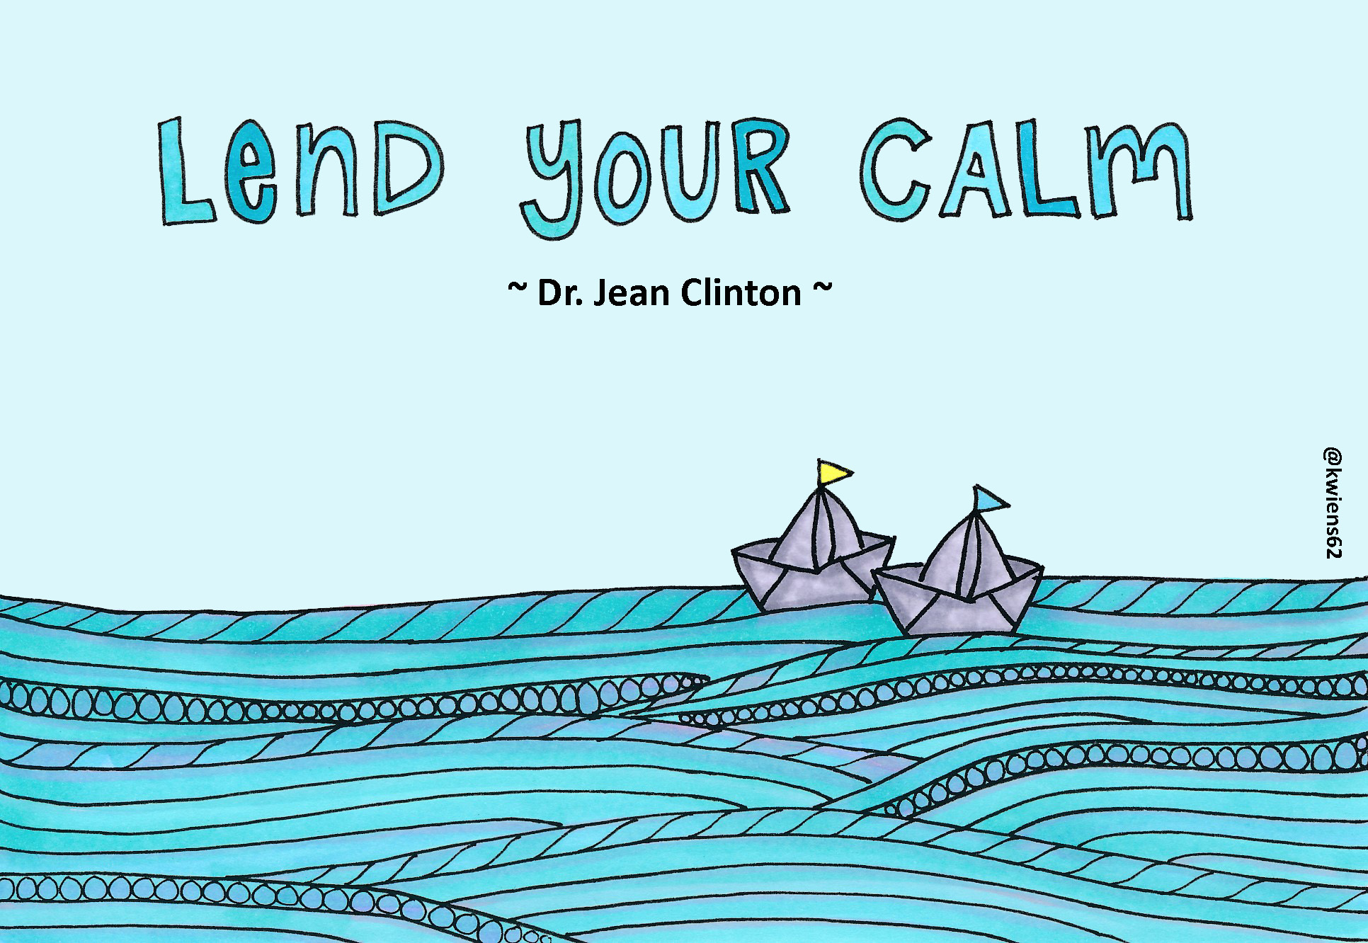
Educator’s Role in Co-regulation
When a child is in a red brain state, it is not the time for an educator to try to reason with them. The child does not have the ability to control their emotions. (You might notice these suggestions align with responding to your child’s cues. (This is because behaviours are cues!)
At these times, children need an adult to help them co-regulate. The role of the educator is:
to stay close by the child until they settle
to physically comfort them if the child will allow
to verbally soothe a child (label feelings)
to have an age-appropriate conversation about what was upsetting the child, after the child is brought back to calm
create calming environments
Watch this short video by Dr. Jean Clinton on how to be a co-regulator.
Lend your calm

Slide 21

There are many strategies educators use throughout the day to help children understand about their own body’s stress cues.
The Resource/Quality Inclusion Coach for your program is a helpful source for information to help you learn some of these strategies.
Ask your supervisor how you can connect with your program’s Inclusion Coach.
Some of the most current research about self-regulation comes from the MEHRIT Centre which is in our community!

Slide 22

The MEHRIT Centre
Dr. Stuart Shanker of the MEHRIT Centre (a self-regulation program based in Peterborough) has developed a response to support children who are having difficulty regulating.
You can find a number of resources and professional learning opportunities at the MEHRIT Centre https://self-reg.ca/resources/
The response Dr. Stuart Shanker has developed can be found on the next slide.
This technique is helpful to consider when the child is having difficulty regulating but also after to reflect upon how to help the child for future.
Learn more about the MEHRIT Centre here.

Slide 23
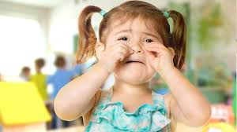
The Shanker Method for Self-Regulation©
Sometimes we might make assumptions that angry, or sad behaviours are disobedience when they are in fact, a stress response.
When a child has lost control:
Ask yourself, “Is this a stress response?”
Ask, “Why is this behaviour happening and why now?”
Reflect on what the stressors might be? (hidden and obvious)
Ask yourself, “Is there a way I can reduce the stressor?” (e.g., change the environment, alter the schedule of the day, give the child more connection time, etc.)
How can we move forward to help the child to regulate in the future (anticipate/prevent)?

Slide 24
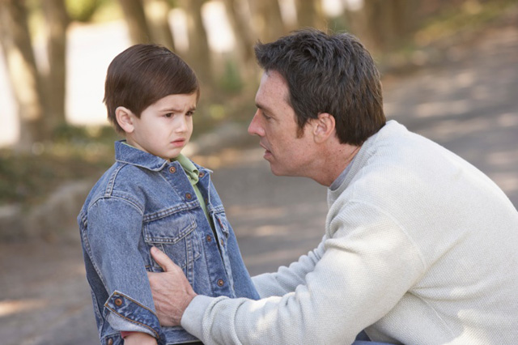
Clear and Consistent Messages Help Children Regulate
Sometimes children become dysregulated because they do not have clear or consistent limits. Limits help children feel safe and secure.
Set
Set clear and simple limits and expectations
Include
Include children in limit setting and decision making as much as possible
Restate
Restate expectations when needed
State
State consequence if behaviours continue
Follow through
Follow through with consequences
Be calm
Be calm and matter of fact when guiding behaviour
Say Yes
Say yes whenever reasonably possible
Notice
Notice when children do things right
Consistent
Strategies need to be CONSISTENT among team members

Slide 25
Consider the Unique Needs of Children
Some children experience difficulties processing everyday sensory information, receptive and/or expressive language delays, social-communication difficulties, and/or a multitude of other differing abilities that may further impact their ability to self-regulate.
Some children in your program will be on the case load of an Inclusion Coach.
Your program’s coach can share tips and strategies to support building connections unique to each child’s learning style and needs.
For more information go to: College of ECE, Practice Guidelines, Inclusion of Children with Disabilities

Slide 26
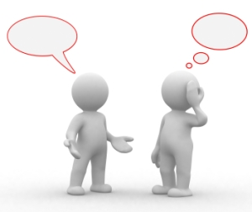
Who are My Partners in Understanding Children?
Your team and supervisor are ideal partners in supporting you to understand a child. Together, as a team, you can reflect on the best way to build connections and relationships with children and why a child may be dysregulated and determine solutions for moving forward
Parents can also be a good source of information about their child. They may know about stressors a child might be experiencing at home that you are not aware of. We call these hidden stressors.
Your program’s inclusion coach from Five Counties Children’s Centre can also be a helpful resource.

Slide 27
When You Are Feeling Overwhelmed
Some things to Consider:
Review your agency’s policies on guiding children’s behaviour.
Talk to your team members or supervisor. Chances are if you are feeling this way, they may be too.
Reflecting together can often help you develop a strategy to help the child.
Is this an issue the team can discuss with the program Inclusion Coach from Five Counties Children’s Centre?
How can the family be involved in this discussion?
Who is the person on your team who should take the lead in this discussion?

Slide 28
When You Are Feeling Overwhelmed…Continued
Ask yourself, how can I support more ‘connection’ time with the children?
(C:D:C ratio- Correction, Direction and Connection)
Take advantage of the resources in our community listed on the final slide.
How can I take time for ‘me’ to help my own self-regulation and well-being?
You cannot help a child to regulate if you are not regulated yourself.

Slide 29

The Child Care and Early Years Act: Prohibited Practices
As an educator in an early learning and care program, it is important to know about and follow the Child Care And Early Years Act (CCEYA). The purpose of this Act is to foster the learning, development, health and well-being of children and to enhance children’s safety.
The Act describes practices that are prohibited with children and are important for you to be aware of.
Click on the link below to learn more about the CCEYA and a link to the full document.
Child Care and Early Years Act
Section: Programs for Children
Regulation 48: Prohibited Practices

Slide 30

Remember that without a positive and nurturing connection, it is difficult to build relationships.
When a child is having difficulty regulating, make the connection your priority.

Slide 31

Where to Access Resources
How Does Learning Happen? -Ontario’s Pedagogy for the Early Years https://files.ontario.ca/edu-how-does-learning-happen-en-2021-03-23.pdf
HDLH? In French https://www.ontario.ca/fr/page/comment-apprend-pedagogie-de-lontario-pour-la-petite-enfance
Think, Feel, Act https://files.ontario.ca/edu-think-feel-act-lessons-from-research-about-young-children-en-2021-01-29.pdf
The MEHIRT Centre https://self-reg.ca/
The Flip It Method https: FLIP IT | Strategy for Challenging Behavior
Investing in Quality Peterborough-Resource Library @ Five Counties Children’s Centre https://www.fivecounties.on.ca/resource-library/
Home - Social and Emotional Learning-Conscious Discipline
Child Care and Early Learning Act https://www.ontario.ca/laws/statute/14c11

Slide 32

Reflecting Forward
Please take the time to review your learning from this module with your supervisor/lead and or team members
Thank you for taking the time to complete this module. We hope that it helps you in your day-to-day practice with children, families and other educators.

