Slide 1




How Does Learning Happen?
Ontario’s Pedagogy for the Early Years
Investing in Quality Peterborough
Module 1

Slide 2
Purpose of these Training Modules
This presentation is part of a series of training modules for supply and non-ECE staff working in Early Learning and Care in Peterborough City and County. Training for these important staff has been identified as a priority in our community.
Along with How Does Learning Happen?, this on-line series also consists of three additional modules on the following topics:
Responsive, Caring Relationships
Child Led Approaches to Learning
Child Development

Slide 3












LEGEND
Throughout this presentation you will find symbols to indicate how to engage with the material.
Click the link to read the required material
Click the link provided to watch the video
Reflect on the reading or video materials and take notes about your reflections to share with your supervisor

Slide 4
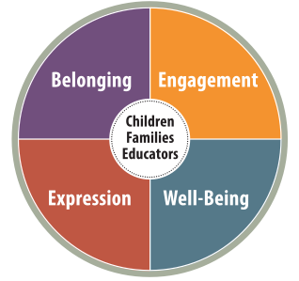
Agenda
Background
HDLH? A Pedagogy for the Early Years
The Four Foundations
Reflective Practice
Take time to write your thoughts and responses to some of the questions. This will help you understand the material better.
Along with these slides, you will find links for articles to read and videos to watch.

Slide 5


‘How Does Learning Happen?’
How Does Learning Happen? (HDLH?) is the document used by all early learning and care programs, including licensed centre based and home childcare programs, before and after school care, nursery school and EarlyON programs in Ontario.
This module introduces the key concepts from HDLH? for all individuals working in this sector.
You can download a copy of HDLH? Online.
    How Does Learning Happen?
    Comment append-on?

Slide 6
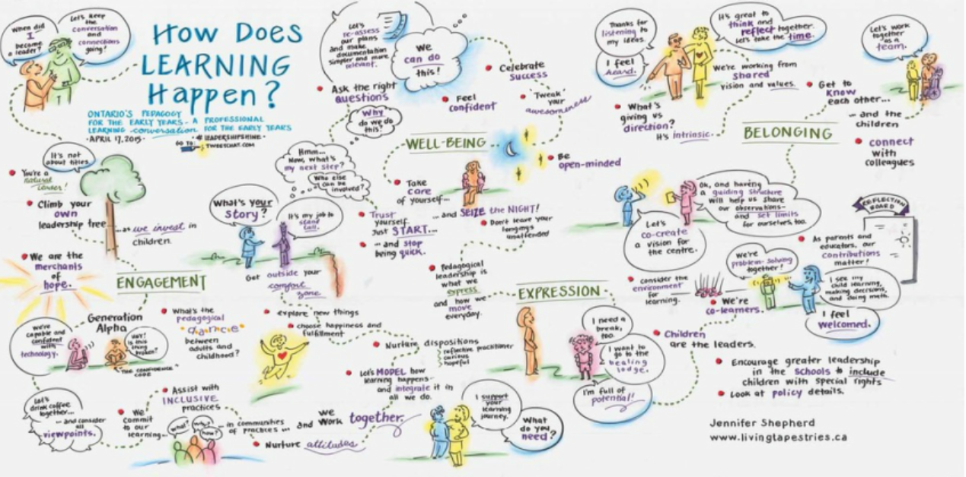

Slide 7
The Development of
‘How Does Learning Happen?’
In 2007, Ontario put out ‘E.L.E.C.T. (Early Learning for Every Child Today): A Framework for Ontario Early Childhood Settings’.
Research and knowledge about the early years and child development were rapidly expanding and in 2014 the Ministry of Education introduced the new document: How Does Learning Happen?
HDLH? applies to all early learning and care programs (e.g. centre and home-based child care, child and family programs, before and after school programs).
It offers a vision for Ontario’s early years and provides the opportunity for all those working in this sector to use the same language and understandings in their work. This was a significant change in the province.
Before this, each program might approach and interpret the work in widely different ways. HDLH? allows us to talk with each other, share ideas and understandings in a way that didn’t exist before.

Slide 8

Global Influences behind HDLH?
Ministry of Education staff researched what was happening globally.
HDLH? was influenced by information and research from other countries including Australia, New Zealand, Finland and Italy.
Major advances in brain research, especially in the very young, created the need to develop a new framework for early learning and care programs.
An improved understanding of child development has helped us move to seeing children as capable and competent rather than seeing them as blank slates.
All of these influences contributed to the development of HDLH?

Slide 9
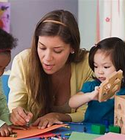
A Vision for Ontario’s Early Years
“There is perhaps no relationship that holds greater responsibility or reward than the relationships we develop with children.” (p.4)
HDLH? is intended to support learning through relationships. The vision is child and family centred.
While the family is the primary source of learning and relationships, we know that early learning and care programs play an important role.
Children thrive in programs where adults are caring and responsive and where there are rich opportunities for them to engage in active learning and play.
HDLH? is described as ‘a resource about learning through relationships for those who work with young children and their families’. (p.5)
Note: HDLH? Refers to all the people who work with children and families in early learning and care programs as ‘educators’.

Slide 10

A Pedagogy for the Early Years
HDLH? is a pedagogy: This term is unfamiliar to many people. You may be more familiar with the term ‘curriculum’.
Pedagogy: A pedagogy is “the understanding of how learning takes place and the philosophy and practice that support that understanding of learning”. (HDLH p. 5)
Curriculum: a curriculum is about the ‘what’ or the content of learning. It includes everything that happens in a program such as the physical space and the educators (the structure).
HDLH? is intended to support pedagogy and curriculum/program development in early years programs.

Slide 11

‘How Does Learning Happen?’
Have you noticed that ‘How Does Learning Happen?’ is a question?
This document is not so much about providing all the answers, but rather is intended to provoke questions – for it is in exploring our questions that learning happens”.
Take a moment to consider all the different ways you have learned in your life.

Slide 12

Getting Started
Think back to one of your earliest memories from school or child care.
What do you remember about it? How did it make you feel?
Why do you think you still remember it?
We are building memories everyday in our work.
Write down what you hope the children you spend
time with will remember from their time with you.

Slide 13
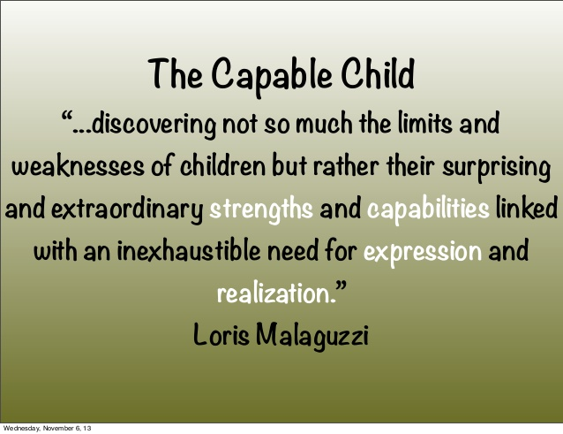
The View of the Child
How we think of children affects how we respond to them, what we offer them and what we expect.
HDLH? offers an image of the child as ‘competent, capable of complex thinking, curious and rich in potential’. This may be in contrast to an older view of children as ‘blank slates’ and as incomplete.
HDLH? asks us to take a strength-based approach. “What are the unique strengths and needs, approaches, attitudes, and dispositions of each child?” (p.18)

Slide 14
HDLH? is based on four foundations
Here are the foundations along with the goals for children. You will notice that children, families and educators are all at the heart of the foundations:
  Belonging: Every child has a sense of belonging when they are connected to others and contribute to their world.
  Well-Being: Every child is developing a sense of self, health, and well-being.
  Engagement: Every child is an active and engaged learner who explores the world with body, mind and senses.
  Expression: every child is a capable communicator who expresses themselves in many ways.
Along with these foundational goals for children, there are also expectations for programs.

Slide 15
Belonging (p. 24)
Goals for Children | Expectations for Programs
“Every child has a sense of belonging when he or she is connected to others and contributes to their world.” | “Early childhood programs cultivate authentic, caring relationships and connections to create a sense of belonging among and between children, adults, and the world around them.”
Consider places where you feel a sense of belonging. What evokes that feeling?
What emotions are tied to belonging?
Think about your home. What makes it a place that shows it is your home?

Slide 16
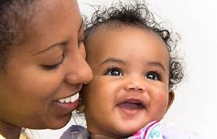
Belonging
Being able to see yourself reflected in the environment can help to create a sense of belonging. Feeling that others really know you and that your ideas matter also contributes to this.
Child care programs are a ‘home away from home’. They should offer warm and inviting spaces to children. Photos are one way to support this foundation.
Consider how photos in a program might help to reduce stress for children while supporting their sense of belonging.
Images might include photos of families in engaging in activities together, pets in a child’s life, photos of their extended family, etc.

Slide 17
Well-Being (p. 29)
Goals for Children | Expectations for Programs
“Every child is developing a sense of self, health, and well-being.” | “Early childhood programs nurture children’s healthy development and support their growing sense of self.”
Think about what contributes to well-being, both when on your own and when you are in a group. Make a list of all the things you come up with.
How many of these would also apply to the well-being of children?
  of families?
  of other educators in a program?

Slide 18
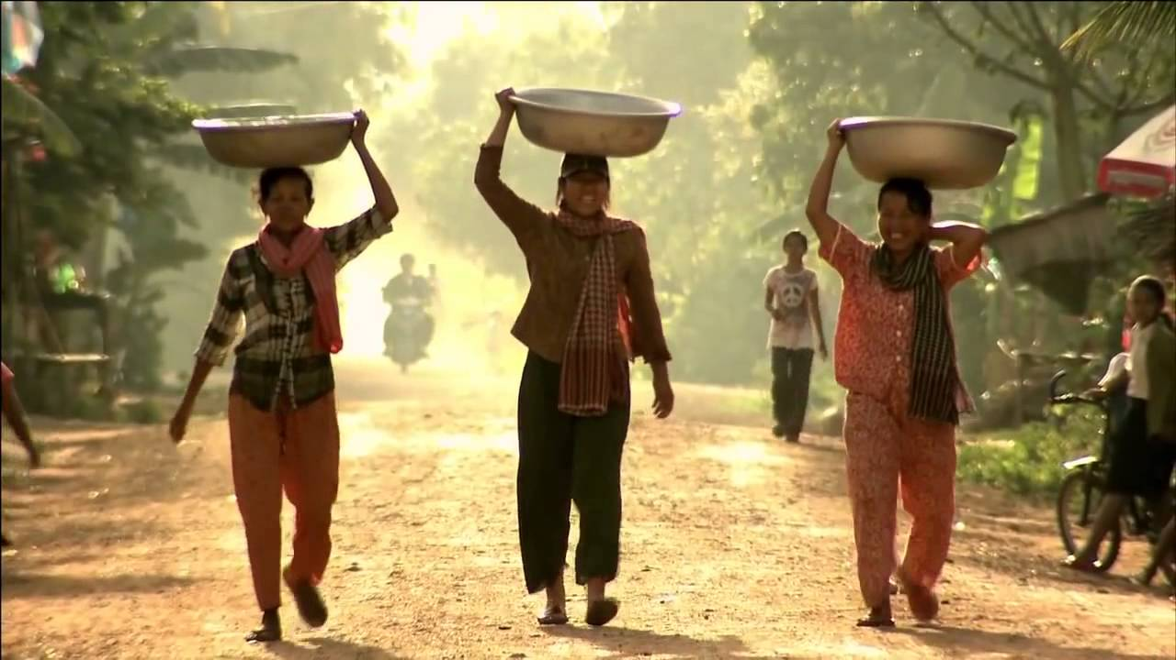
Well-being
Bringing in elements of nature, using natural lighting, having cozy or quiet places to go to, and spending time outdoors are all ways to support well-being. Healthy nutrition and physical activity also support the well-being of children.
Here is a video about well-being. It connects to HDLH? by supporting the idea of looking outside the box for solutions to problems. It also offers a broad view of what well-being might look like in our lives.
The Lucky Iron Fish Project

Slide 19
Engagement (p. 35)
Goals for Children | Expectations for Programs
“Every child is an active and engaged learner who explores the world with body, mind, and senses.” | “Early childhood programs provide environments and experiences to engage children in active, creative, and meaningful exploration, play and inquiry.”
‘ “Engagement” refers to a state of being genuinely involved and interested in what one is doing.’ (HDLH? P. 53)
Engagement goes beyond being occupied or busy. When children are engaged, they will often play for an extended period and be less likely to be distracted.
Engagement is more likely when children are the ones choosing what materials they will use.

Slide 20
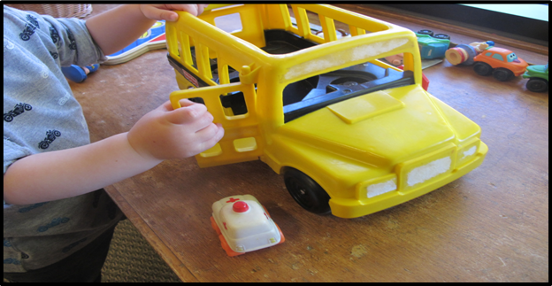
Engagement
The child in this photo was engaged for many minutes exploring all the different ways people and smaller vehicles could go in and out of the doors and windows.
What might this child have been wondering about?
Perhaps they are gaining a sense of all the possibilities? Perhaps they are developing an understanding of space and how big or small the windows and people are? This would be the foundation for early math.
Often when we are deeply engaged with something, we can lose track of time. What do you think is the difference between a child who is ‘busy’ and a child who is ‘engaged’?
Here is a video clip which talks about the curiosity and wonder of young children:
  Curiosity and Wonder

Slide 21
Expression (p. 41)
Goals for Children | Expectations for Programs
“Every child is a capable communicator who expresses himself or herself in many ways.” | “Early childhood programs foster communication and expression in all forms.”
‘When educators are aware of and able to understand and respond to the many “languages” children use to communicate, they give children a “voice”.’
‘Conversation can occur with even the youngest infants when adults are attuned to the child’s subtle verbal and non-verbal cues and gestures and when they respond by interacting in “serve and return” exchanges.’
‘Opportunities for children to explore language and literacy through play contribute to their development of strong language and cognitive abilities…..’(p.42)

Slide 22
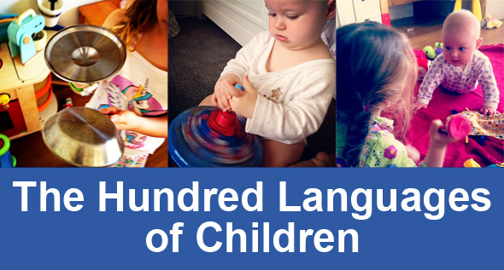
Expression
We express ourselves in many different ways. Speech is one way but there are many others. Are you involved in any of the following? They are all examples of how we might express ourselves:
‘Communication also occurs through creative expression.’ Loris Malaguzzi, the founder of the Reggio Emilia schools in Italy, wrote a poem about the many ways in which children express themselves. It was called ‘The Hundred Languages of Children’.
The Hundred Languages of Children
Gardening
Sewing
Singing
Sports
Cooking
Knitting
Painting
Writing
Woodworking
……..

Slide 23
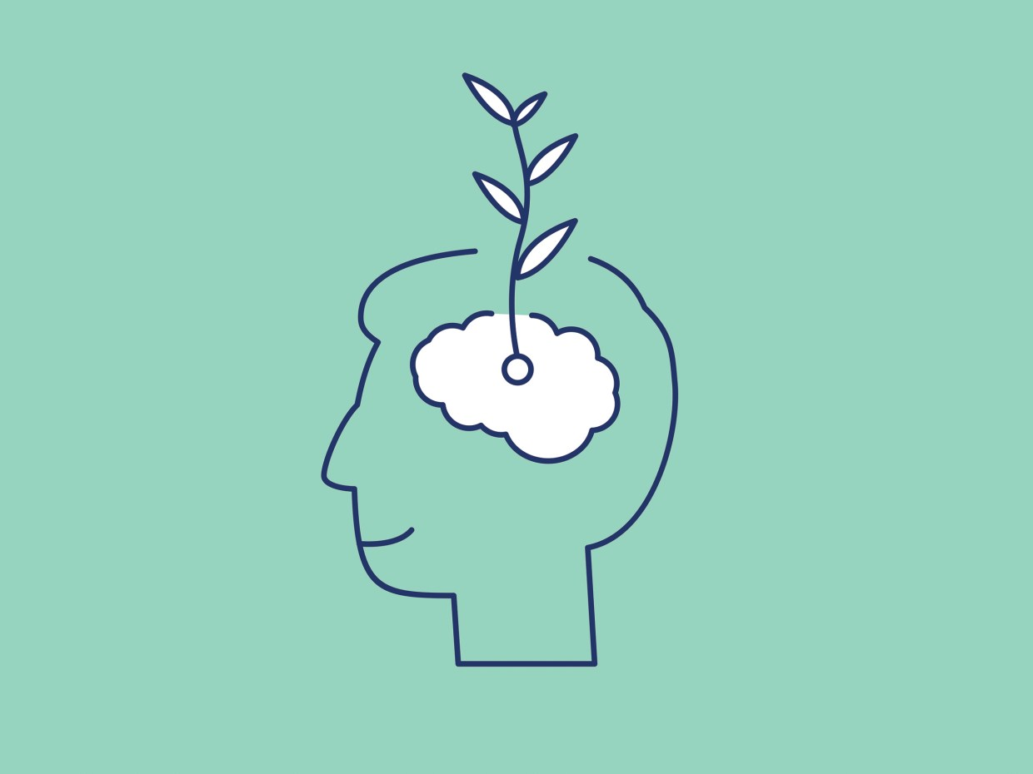
Understanding Reflective Practice
One of the ELECT principles says, ‘Knowledgeable, responsive and reflective educators are essential.’ (p. 10)
Ongoing opportunities to engage in reflection and discussion with others are a keyway educators can continue their own professional learning. Reflective questions are embedded throughout the document. Educators and administrators are challenged to discuss and reflect on ‘their taken-for granted beliefs and practices’. (p.12)
At the end of each foundation section, there are a selection of reflective questions. For example, under Well-Being (p. 34), one question is:
  “What environmental factors may be causing stress for children? What changes could be made to reduce stress for all who use the space?”
This question offers us the chance to step back from the daily routine and consider the many different elements that shape each day.

Slide 24
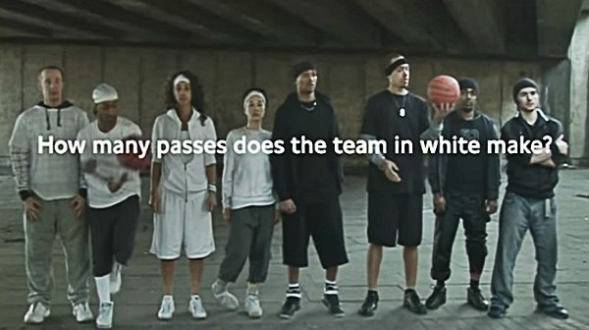
Noticing
One important skill in early learning programs is the ability of educators to notice what is happening and to be curious about it. This goes beyond simply looking at things. Here is a video to watch which supports this idea: Awareness test
When we are busy in the moment, we can lose sight of the smaller details. If we can slow down and notice, we may see things differently or gain new information and insights.

Slide 25
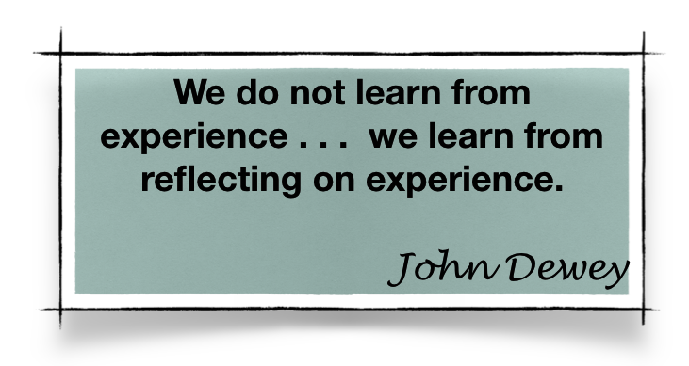
Reflecting
Consider this quote from authors Corita Kent and Jan Steward:
“It takes practice for us to recover this ability to see, or before that, the gift of wanting to see. For so many years we have been learning to judge and dismiss - I know what that thing is, I’ve seen it a hundred times – and we’ve lost the complex realities, laws, and details that surround us. Try looking the way the child looks-as if always for the first time.”
Sharing our ideas and thoughts with others can give us new perspectives about situations and people. We encourage you to bring your curiosity and strengths as you work with young children, their families and your colleagues.

Slide 26

HDLH? 2020 and Beyond
“Now more than ever, HDLH is a key support for children, families and educators as Ontario recovers from the challenges of this unprecedented time. We know it is critical to put measures in place to support the immediate health and safety needs of children, families and educators; however, emotional well-being should be given the same level of care and attention. Children need responsive and caring relationships and environments that support exploration, play and inquiry, which have a long-term impact on children’s mental health, well-being and capacity to learn. “
Read the full report here: Building on How Does Learning Happen?

Slide 27
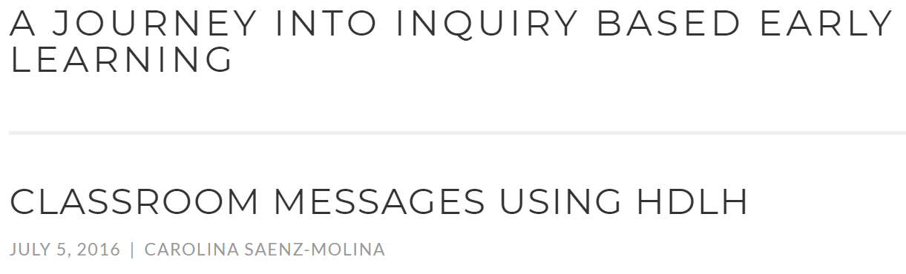
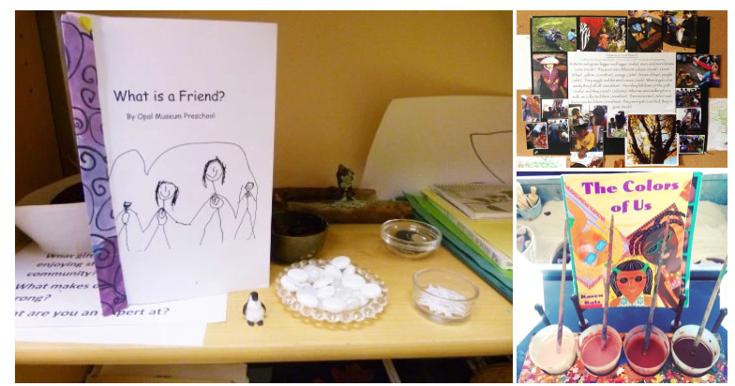
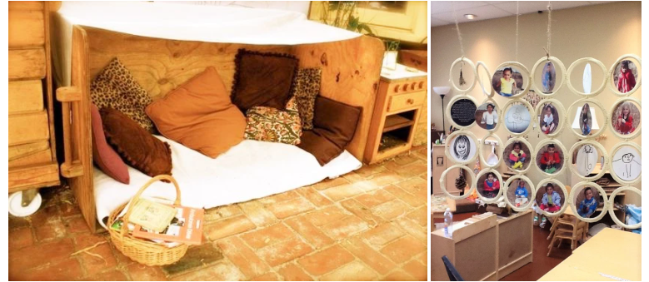
Visit the website below to see some great photographic examples of living into HDLH?
https://journeyingintoinquiry.wordpress.com/2016/07/05/classroom-messages-using-hdlh/

Slide 28
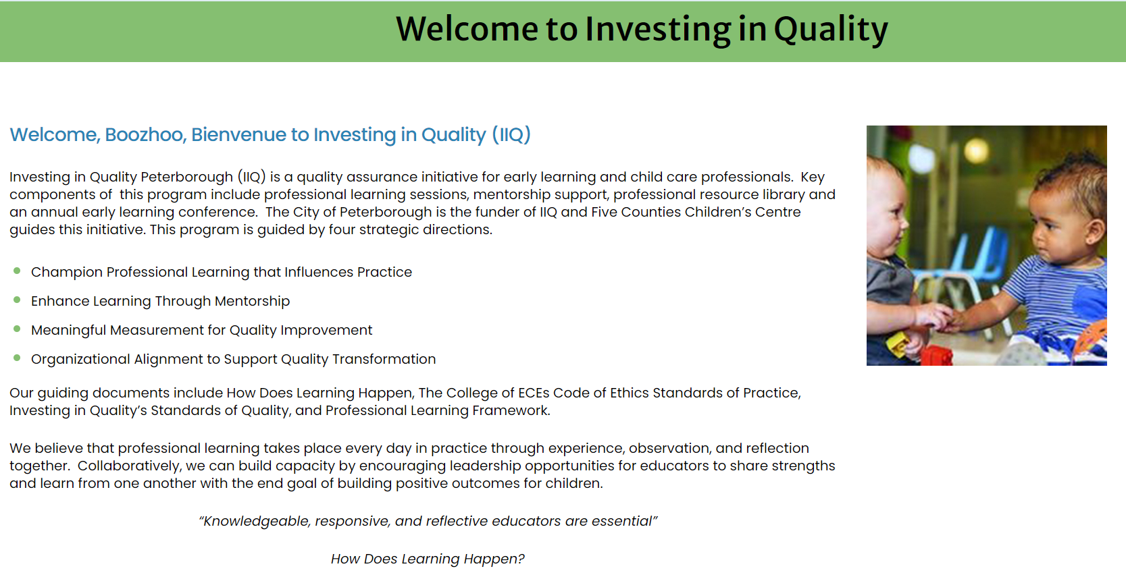
Resources
Visit our resource page on the Investing in Quality website
https://www.fivecounties.on.ca/external-resources-learning-modules/
Here you will find English and French resources related to How Does Learning Happen?
https://www.fivecounties.on.ca/welcome-iiq/

Slide 29
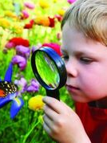
It’s a journey, not a destination.
“As we move around the circle of life, there are certain things we must do if we are to learn and grow.
The first step is to listen. If we do not listen, then we will hear nothing.
The second step is to observe. If we do not look carefully at things, then we will not really see them.”
Joseph Bruchac

Slide 30

Reflecting Forward
Please take the time to reflect with your supervisor and/or team members. Reflecting together helps us to learn from several perspectives. This will support you to take what you have learned here and put into daily practice.
Thank you for taking the time to complete this module. We hope that it helps you in your day-to-day practice with children, families and other educators.

