Slide 1


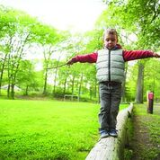

Child Led Approaches to Learning
Learning Module, Investing in Quality Peterboroug,Module 3

Slide 2
Purpose of these Training Modules
This power-point presentation is part of a series of training modules for supply and non-ECE staff working in Early Learning and Care in Peterborough City and County. Training for these important staff has been identified as a priority in our community.
Along with Child Led Approaches to Learning, this on-line series also consists of three additional modules on the following topics:
How Does Learning Happen?
Responsive, Caring Relationships
Child Development

Slide 3












LEGEND:
Throughout this presentation you will find symbols to indicate how to engage with the material.
Click the link to read the required material
Click the link provided to watch the video
Reflect on the reading or video materials and take notes about your reflections to share with your supervisor

Slide 4

Agenda
A Look at Learning
The Role of the Educator
The Role of the Environment
Invitations to Play
Take time to write your thoughts and responses to some of the questions. This will help you understand the material better.
Along with these slides, you will find links for articles to read and videos to watch.

Slide 5
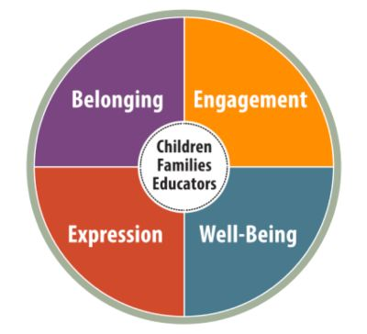
How Does Learning Happen?
The document HDLH? asks us to think about how learning happens. In the past, learning and teaching were often seen as two separate roles where the educator (the adult) gave the information, and the learner (the child) received it. In this view, the role of the learner was seen as passive.
HDLH? takes the view that “children are competent, capable of complex thinking, curious, and rich in potential”. In other words, they are active participants in their learning.
https://files.ontario.ca/edu-how-does-learning-happen-en-2021-03-23.pdf

Slide 6
Reflect:
What does it mean to you to be an active participant in your own learning?
What are some of the conditions that support active participation by the learner?
How does this differ from teacher directed approaches?

Slide 7

Setting the Stage:
Our view of the child
“Education is the kindling of a flame, not the filling of a vessel.” Socrates
HDLH? talks about children, families and educators as co-learners who are constructing learning together. The image of the child article from the educations Hub explains the concepts of the image of a child.
How does the view of filling a vessel for learning differ from following interests for learning? Think of a time you followed your own interests…how was your learning impacted?

Slide 8
Our View of the Child
In the past we looked at children as empty vessels to be filled with knowledge, looking at the child from a deficit model. We now have a new lens to view children through which is competent, capable and curious.
The provincial pedagogy for early learning, How Does Learning Happen? “expands on what we know about child development and invites educators to consider a more complex view of children and the contexts in which they learn and make sense of the world around them. This thinking may require, for some, a shift in mindsets and habits. It may prompt a rethinking of theories and practices”. HDLH? Pg. 17
How might shifting our mindsets to seeing children as competent, capable and curious change how we offer early learning experiences?

Slide 9
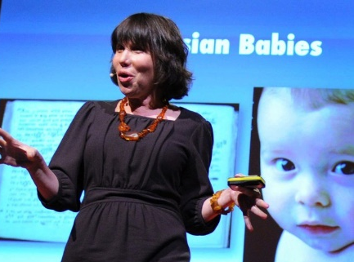
Our View of the Child Impacts
How we Offer Learning Opportunities
Alison Gopnik is a developmental researcher and psychologist. In her article, “Why Preschool Shouldn’t be like School”, she discusses how “direct instruction can be useful for learning specific facts. However, if we want children to develop into thinkers, we should tap into their curiosity, creativity and willingness to experiment”.
Take a few moments to read this article. Make note of what intrigues or surprises you about how children learn?
The article suggests the merit in allowing children to explore without having a particular point or result being the goal. It also shows children’s innate curiosity and their desire to experiment with materials.

Slide 10
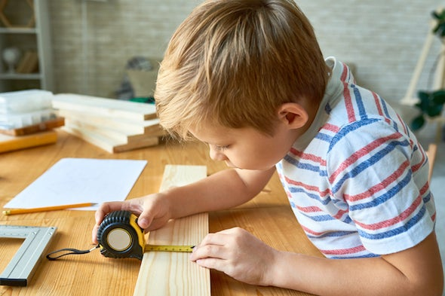
Think about a time where you were allowed to experiment, tinker, learn in a way that made sense to you?
How did this impact how and what you learned?
How does this idea relate to how we work with children? The experiences we offer children?

Slide 11
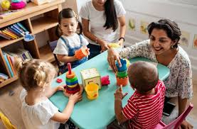
Play as the Vehicle for Learning
Research is showing us that when we are engaged and when our interest is captured, we learn and retain much more than when we are simply presented with information.
We are recognizing that learning happens in many different contexts as well … For example, when a child is babbling in a serve and return interaction with an adult, they are learning about the different sounds, they are watching the adult’s face to see the changes in expression, and they are learning that they play a role in the back-and-forth conversation.
When a child is building a tower with blocks they are learning about early math through shape, balance and weight. They are also learning about trial and error and problem-solving.

Slide 12
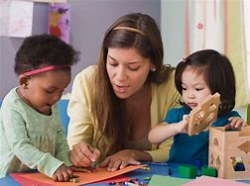
The Role of the Educator in Play
“The role of the educator is multidimensional. The best educators, first and foremost, use a warm, responsive, and inclusive approach, building relationships with children………” (HDLH? p.19)
Through research, we are learning more about how learning actually happens. As mentioned earlier, HDLH? talks about children, families, and educators as co-learners who are constructing learning together. We are recognizing that learning often takes place within relationships.
The educator is not the ‘holder of knowledge’. As adults and educators, we bring our own knowledge and experiences with us. The child also brings their knowledge and curiosity with them. We learn more when we learn together. We may have a tendency to rush to assumptions. As HDLH? says, “it is in exploring our questions that learning happens”.

Slide 13
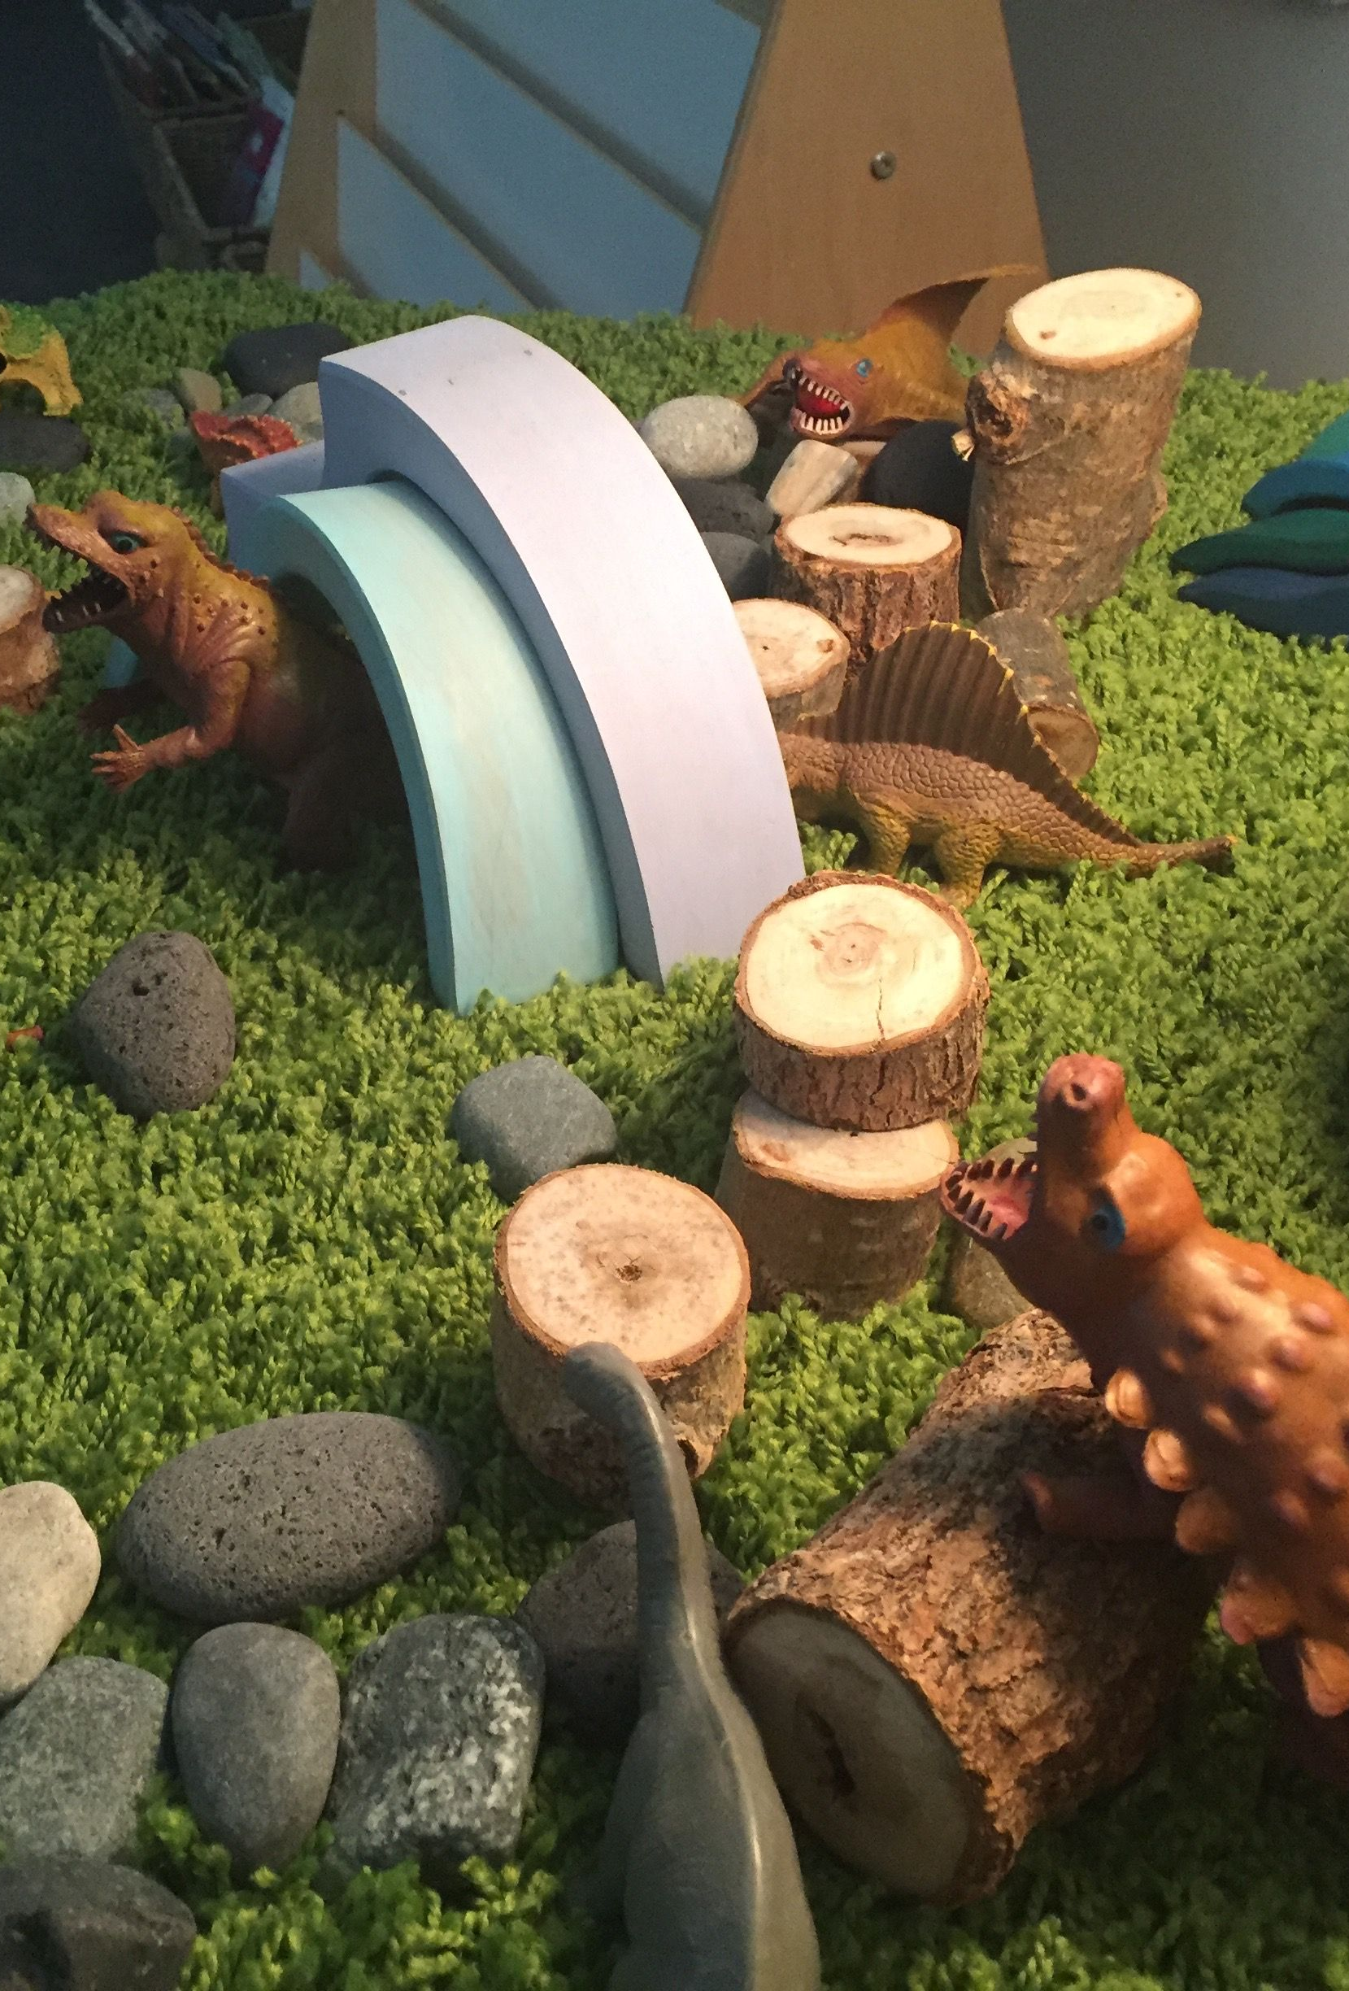
The Role of the Educator in Play… continued
Our role is to be responsive to children’s interests rather than using an adult-driven curriculum. This is often referred to as “emergent curriculum”. We are asked to pay attention to children’s questions and to what holds their interest. This information can guide us in setting up the environment and what experiences to plan for the children.
One way to do this is to look more at ‘how’ children are using the materials (loose parts, toys, equipment) rather than simply ‘what’ they are using. Take, for example, a child playing with dinosaurs. If we simply look at ‘what’, we might offer more dinosaurs throughout the room.
If we look at ‘how’, we might notice if they are building caves for them, using them as family members or friends, or whether they seem interested in the size and power of dinosaurs. Each of these suggest different interests and gives information about what else could be offered.

Slide 14
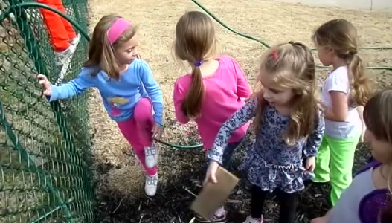
Watch the video on the next slide.
Considering what you see, think about the following questions:
How did the children demonstrate they were capable in guiding their own learning?
How did the environment support the children’s learning?
What was the educator’s role?
What more does this video make you think about?

Slide 15
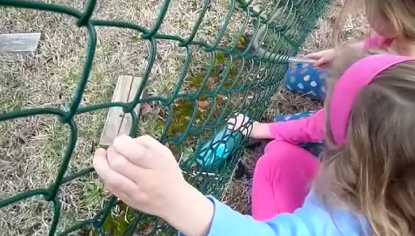
Competent, Capable and Curious in Practice
Clever Teamwork Works

Slide 16
Risk and Children’s Competence
Research has shown that children need opportunities to explore risk in their play.
“When we have kids engage in play, it’s really a fundamental way for them to figure out the world — how the world works, how their body works,” says Mariana Brussoni, adding that these little experiments are all done “in context of a relatively safe space.” Risky play in early childhood can help develop a child’s self-confidence, resilience, executive functioning abilities and even risk management skills.” Brittany Toole
https://www.cbc.ca/natureofthings/features/risky-play-for-children-why-we-should-let-kids-go-outside-and-then-get-out

Slide 17
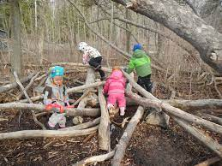
How do we Nurture Risk Competence in Children?
We all have different experiences and different comfort levels with risk.
This includes both what we are willing to try as adults and what we are willing to allow the children to try.
Our past experiences influence our feelings and beliefs about risk.
Before we can support children in exploring risky play, we must first reflect explore our own beliefs.

Slide 18
Reflective Questions to Consider
In the book, Creating a Culture of Reflective Practice (The Role of Pedagogical Leadership in Early Childhood Programs) by Anne Marie Coughlin & Lorrie McGee, Pgs. 106, 108, 110, the authours suggest reflecting on the following questions to help you consider how to allow for safe risk in your practice.
How would you describe your relationship to risk?
What kinds of risks are you willing to take?
What kinds of risks are you adverse to?
How do your beliefs and feelings about risk impact what you offer to children?
What kinds of activities do you notice you are stopping and why?
Where might there be more opportunities to say yes in risky play?

Slide 19
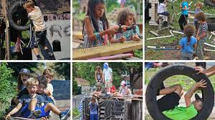
Types of Risky Play
When considering child led risky play consider where children are showing interest. Think about ways you can encourage this interest in a manner that is safe as necessary vs. safe as possible. Also consider the age of the child. Risk for a two-year-old is different than risk for a six-year-old.
Climbing, Jumping, Swinging
Building/Creating Using Real Tools
Speed
Natural Elements, (for example water)
Rough & Tumble Play

Slide 20

Child Led Play
HDLH? is not directed at the formal school setting. It is intended for all early learning and care programs (e.g. centre and home-based child care, child and family programs, before and after school programs).
HDLH? states clearly that the “focus is not on teaching a body of knowledge…”(p.15). The aim is to support the growth and development of the whole child and to have long-term positive outcomes for all children.
While all four foundations support the value of a child-led curriculum, ‘engagement’ is described as ‘creating contexts for learning through exploration, play and inquiry’.

Slide 21
Engagement (p. 35)
Goals for Children | Expectations for Programs
“Every child is an active and engaged learner who explores the world with body, mind, and senses.” | “Early childhood programs provide environments and experiences to engage children in active, creative, and meaningful exploration, play and inquiry.”
“Engagement” refers to a state of being genuinely involved and interested in what one is doing.” (HDLH? P. 53)
Engagement goes beyond being occupied or busy. When children are truly engaged, they will often play for an extended period and be less likely to be distracted.
Engagement is more likely when children are the ones choosing what materials they will use. It is also supported when there are open-ended materials to use and time to explore them.

Slide 22
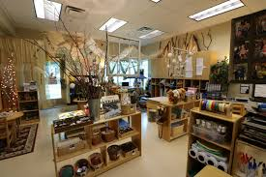
The Role of the Environment
(The environment as the third teacher)
In order for learning to happen successfully, we must set the stage. “The environment is the context in which learning takes place.” (HDLH? p.20)
Loris Malaguzzi, founder of the Reggio Emilia schools in Italy, spoke of the environment as ‘the third teacher’. HDLH? paraphrases him as saying the environment is “valued for its power to organize, promote relationships, and educate. It mirrors the ideas, values, attitudes, and cultures of those who use the space.” (HDLH? p.20)
Consider how different environments affect how you feel and what you do. When you look at the spaces where children play, are there different areas for pretending, creating, building, gathering together, or to have quiet time away from others?

Slide 23
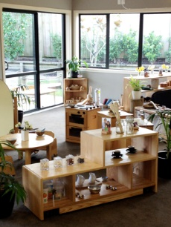
The Role of the Environment…continued
In the past, it was common for programs to have a stable curriculum plan over the year. Some examples might be that October is ‘apples’, and ‘autumn’, with many of the activities and materials reflecting this focus.
While we may still bring elements of autumn into the environment during September/October, we will also be curious to see what interests the children have.
For example, we might notice them wondering what happens to the insects in the colder weather, noticing the differences in the leaves, exploring the physics of a rolling pumpkin or cooking with vegetables. A responsive educator will look for ways to extend these interests over time.

Slide 24
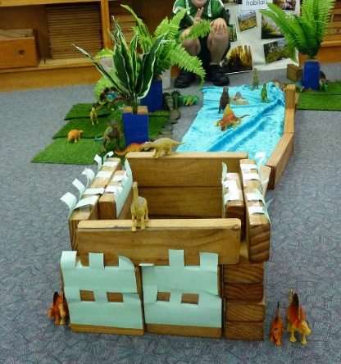
The Role of the Environment…continued
The College of Early Childhood Educators Practice Guideline, Supporting Positive Interactions with Children, talks about the importance of designing and modifying environments that support children’s self-regulation, independence, reasonable risk taking, meaningful exploration and positive interactions. Pg. 10 Practice Guidelines
Read the guideline listed in the link above.
Note down something new you learned from reading this article
and something you are still wondering about.

Slide 25

Environmental Supports to Learning
Some Considerations…
  Provide a variety of complex materials and mediums which offer rich opportunities for play and exploration
  Offer long stretches of uninterrupted time to allow play to deepen and exploration to happen
  Minimize the number of transitions in a child’s day
  Allow opportunities to revisit ideas from previous days
  Consider ways of making the learning visible so that it can be shared, discussed and extended (e.g., photos and pedagogical documentation).
  The Investing in Quality Resource Library has resources on documentation that you can borrow to further your knowledge. https://www.fivecounties.on.ca/resource-library/

Slide 26
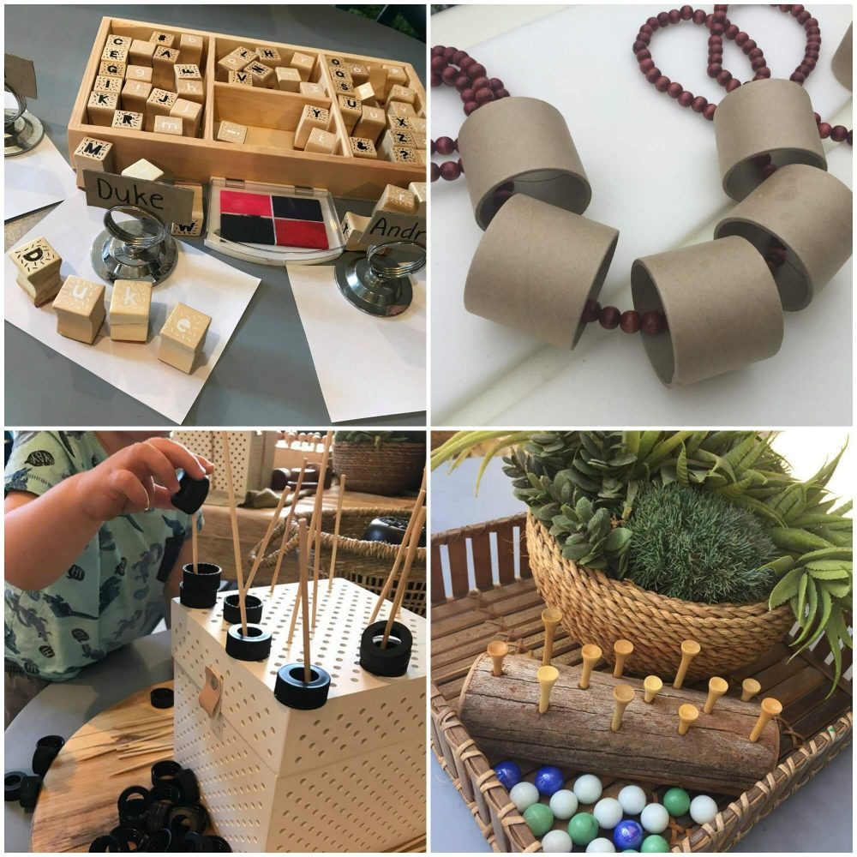
Invitations to Play
Educators provide materials and experiences based on observations of children’s interests. One way to provide rich opportunities is to create ‘invitations to play’.
An ‘invitation to play’ is arranging the environment so that it “invites” young children to come to an area in the room to explore, investigate, question, examine, participate, touch, and manipulate materials in a way that makes sense to them. The materials offered might be based on interests the children are demonstrating, schemas of play they are engaging in, or new materials they have not encountered in the past.
There is no right or wrong way to interact with an invitation to play and children should be offered the opportunity to use the materials in any way they choose.

Slide 27
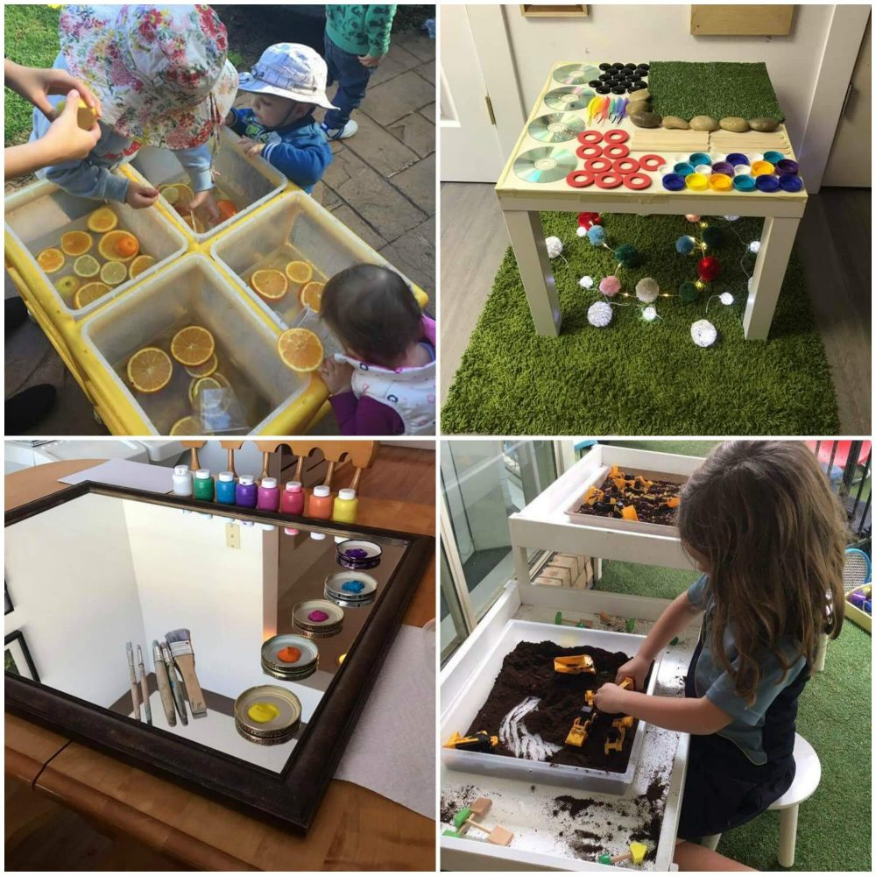
Some Examples
Examine the invitations to play in these pictures…
Think about why an educator might offer these materials?
What might the children do with them? What else might they do?
What might the children learn by exploring these materials?
What other materials could you add to these invitations?

Slide 28

It’s a journey, not a destination.
“As we move around the circle of life, there are certain things we must do if we are to learn and grow.
The first step is to listen. If we do not listen, then we will hear nothing.
The second step is to observe. If we do not look carefully at things, then we will not really see them.”
Joseph Bruchac

Slide 29

Reflecting Forward
Please take the time to review with your supervisor and/or team
Thank you for taking the time to complete this module. We hope that it helps you in your day-to-day practice with children, families and other educators.

