Slide 1


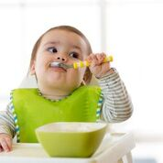

Child Development
Investing in Quality Peterborough
Module 4

Slide 2
Purpose of this Learning Module
This power-point presentation is part of a series of learning modules for non-ECE staff working in Early Learning and Care in Peterborough city and county.
Professional learning for these important staff has been identified as a priority for our community.
Along with Child Development, this on-line series also consists of three additional modules on the following topics:
How Does Learning Happen?
Responsive, Caring Relationships
Child Led Approaches to Learning

Slide 3












LEGEND:
Throughout this presentation you will find symbols to indicate how to engage with the material.
Click the link to read the required material
Click the link provided to watch the video
Reflect on the reading or video materials and take notes about your reflections to share with your supervisor

Slide 4

Agenda
Continuum of Development and Milestones
Early Learning for Every Child Today (ELECT)
Domains of Development
Brain Research and Development
Providing a Space for Learning to Happen
Supporting Development
When you Have Concerns
Guiding Behaviour

Slide 5
Developmental Milestones
Children’s development follows a sequence of predictable steps (in the pathway of development.)
Developmental milestones in children are major markers of accomplishments and learning.
There are norms for age-level expectations (a continuum of development) but they always represent a range and NEVER an exact point when specific skills are to be achieved.
Developmental progress is often not smooth and sometimes children have regressions especially during times of stress.
As educators it is important for us to know what ‘typical’ development is so we are aware when a child may be struggling and therefore,we can consider ways in which we can support them while in our care.

Slide 6
The ELECT
ELECT
The Early Learning for Every Child Today (ELECT) document was developed as a resource for general development.
The ELECT outlines the sequence of skills that children at different ages can be expected to acquire across broad developmental domains (physical, social, emotional, communication/language and cognitive).
It also provides examples of interactions that support early learning and development.
It’s important to understand child development to offer appropriate experiences for children and to have appropriate expectations.

Slide 7
The Domains of Development
The Elect outlines a child’s development in five key domains: social, emotional, communication, language & literacy, cognition.
It reviews a Continuum of Development. Note this continuum is not a tool to assess children’s progress against a set of benchmarks. It is also not a screening tool to identify developmental difficulties.
It is a general guide.
Social
Emotional
Communication, Language & Literacy
Cognition
Physical

Slide 8
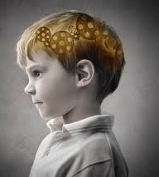

Brain Research
All children are born with huge potential.
Research confirms that the first five years are extremely important for the development of a child's brain.
Early experiences provide the base for the brain’s architecture and have a direct impact on children’s learning and long term social/emotional and physical health.
Nurturing and responsive relationships are key to a child’s healthy brain development as well as health & nutrition.
It is through self-directed play that children learn best.

Slide 9

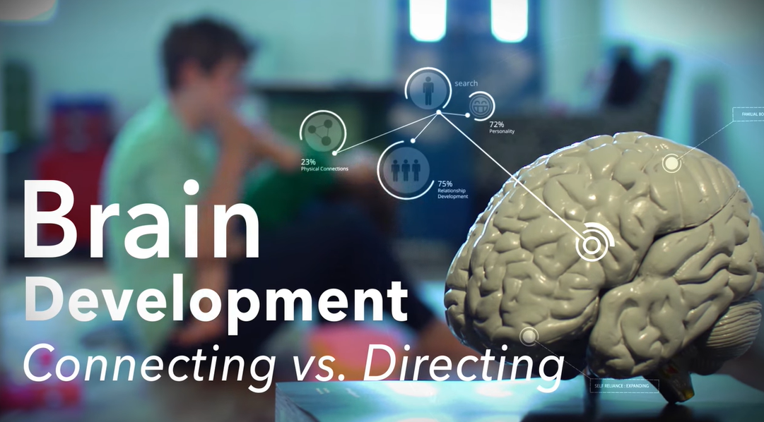
Watch the video with Dr. Jean Clinton
“The power of play”
Key Messages:
Building the brain through relationships and play is the most crucial part of child development.
Warm, nurturing, responsive relationships help children learn and regulate.
Think of relationships and connections before any other kinds of interactions: remember the connection-direction-correction ratio from module 2. Brain Development: Connecting vs. Directing Video

Slide 10

Reflect:
How do nurturing and responsive relationships support healthy brain development?
What does a warm, responsive, caring relationship look like?
What do you see, hear and feel?

Slide 11
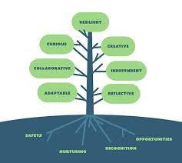
Dispositions for Learning
We have discussed the developmental domains and milestones and explored the idea of the continuum of development. Part of our role as educators is to support the skill development in children and more importantly supporting the growth of learning dispositions in children.
Learning dispositions are traits such as persistence, curiosity, mindset, reflectiveness, creativity, caring, etc.
These are the habits that help everyone to learn and grow. If you are learning a new skill and do not have persistence, you may give up and not accomplish the skill you had set out to learn.
Think about persistence in a baby when they are learning to walk. They fall frequently and keep getting back up and trying. This leads to eventual success to the skill of walking. Without their persistence the skill would not be achieved.
Often when children are 3-4 years old, they may begin to internalize messages from society and begin to tell themselves they cannot do something or see something from a negative mindset. It is our job as educators to nurture positive dispositions and help them to practice them.
What are Dispositions?

Slide 12
How Can we Nurture Positive Dispositions?
We can start with noticing our own positive dispositions.
What are they? How can we nurture and practice them?
Dispositions will help children learn how to think as opposed to what to think.
Notice when you observe a child who is demonstrating a positive disposition.
Help them make the connection….tell them what you notice…name the disposition.
Ask them what they feel, versus what they know.
Provide the time and space for children to explore their curiosities.
Know that it is okay not to have all the answers…you can find the answers together.

Slide 13
Supporting development through learning environments
Read the article below to begin an exploration as to why environments matter to a child’s learning and development.
Environments Matter for Children's Learning & Development
In what ways do I develop environments that:
Encourages curiosity and lifelong love of learning
Builds independence and self-confidence
Supports emotional well-being and social skills
Inspires creativity and problem-solving

Slide 14
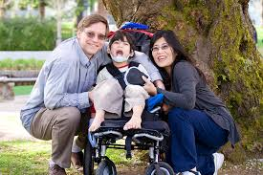
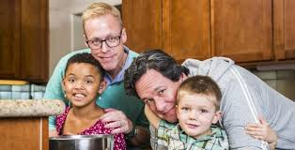
Supporting Development within the Context of Families
Read the statements below which are taken from How Does Learning Happen? Ontario’s Pedagogy for the Early Years, Page 7.
Ask yourself how you demonstrate your beliefs in these tenants in your daily practice.
Families are competent, capable, curious and rich in experience.
Families love their children and want the best for them.
Families are the experts on their children.
They are the first and most powerful influence on their children’s learning, development, health and well being.
Families bring diverse perspectives.
Families need to feel they belong and are valuable contributors to their children’s learning.
Families deserve to be engaged in meaningful ways.

Slide 15
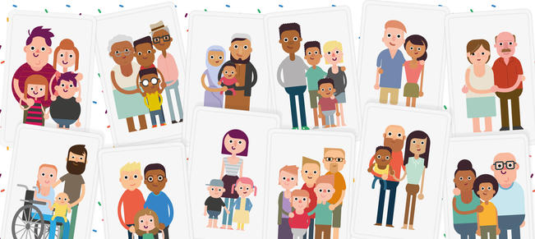
Reflect
How do I invite families into conversations about their child?
How do I listen to parent’s knowledge and views about their child?
How do I engage parents in their child’s learning in meaningful ways?

Slide 16

Supporting Development When Stressed
Stimulating environments, an understanding of what children need, good communication with parents, and supportive team members are all conditions that help support a child’s development. We all know there are never ‘ideal’ conditions, so what can we do to support children when they are stressed and ‘act out’ with behaviours?
Start with your own well-being and self-regulation first
We cannot support children to calm themselves when we are not calm ourselves
Notice what environments and activities ‘stress’ you?
What do you notice about your body when you are stressed?
What strategies do you use to calm yourself?

Slide 17

Guiding Behaviour
Why Children Behave the Way They Do
There are many reasons children struggle with managing their emotions and behaviour. The educator’s role is to set a consistent environment that meets children’s needs. When children struggle with their emotions it is our job to lend them our calm. Sometimes when children act out it is because of stress. (See Module 2: Responsive, Caring Relationships)

Slide 18
Some Possible Reasons for Children Not Regulating
Their physical needs are not being met…hunger, thirst, tired, hot, cold, etc.
They have learning differences that effect their understanding and processing of requests and expectations
They need attention (sometimes if children do not get attention, they will act out to get their needs met, as negative attention is better than no attention)
Unrealistic demands are being placed on them such as long waiting times, many transitions, etc.
The environment may be overwhelming for them (too loud, busy, bright lighting, etc.)
They are experiencing different expectations between home and school
They are testing their independence
They are experiencing hidden stressors

Slide 19
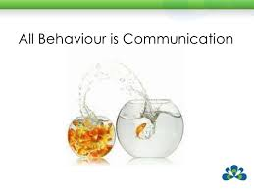
When Children’s Dis-regulation Impacts their Ability to Learn
It’s important to observe behaviour over a period of time to determine the cause. REMEMBER BEHAVIOUR IS COMMUNICATION.
Ask yourself questions. What happened before the behaviour that might have impacted the child’s response? Is there anything about the room environment or the routine that might be impacting the child’s response? Is there anything about your reaction to the behaviour that is reinforcing it?
Are there stressors the child might be experiencing that are unknown to us? How could we find this out? How might the child’s family be helpful in understanding the behaviour?
How might learning differences or needs be impacting this situation?
Communicate with your team members about what you are observing to try to determine together why the behaviour is happening.
Once you understand the “why”, together you can develop solutions to support success for the child.

Slide 20
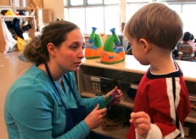
Helpful Hints for Toddlers
Sometimes children will test limits. This is a typical part of child behaviour and development. It is a way for them to learn about rules and how to become independent thinkers. Children will need reminders. Our role is to help guide them in a positive manner and lend them our calm. Often behaviour is because a child is not regulated.
Set reasonable limits
Use simple, plain language
Give transition warnings
Limit the number of transitions and waiting times for children
State what is expected
Redirection
Say yes whenever reasonably possible
Notice when they do things right
Strategies need to be CONSISTENT among team members
(See Module 2 on Responsive, Caring Relationships)

Slide 21

Helpful Tips for Preschoolers and School-Aged Children
Set
Set clear limits
Include
Include children in rule setting and decision making as much as possible
Limit
Limit the number of transitions and waiting times for children
Restate
Restate expectations when needed
State
State consequences if the behaviour continues
Follow through
Follow through with consequences
Be
Be calm and matter of fact when guiding behaviour
Say
Say yes whenever reasonably possible
Notice
Notice when they do things right
Be
Strategies need to be CONSISTENT among team members
(See Module 2 on Responsive, Caring Relationships)

Slide 22
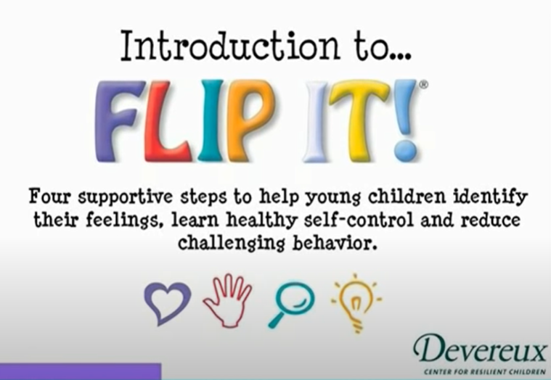
I Need Help
Sometimes guiding children’s behaviour is difficult and we need additional supports and that is okay. We all can find this challenging at times. There are a number of resources you can turn to including the ‘Flip-It’ strategy from the Devereux Center for Resilient Children.
The Flip It Strategy
A Video Outlining the Flip It Steps
*Other resources will be outlined in the resource section of this presentation.

Slide 23




Talk with the child about his feelings.
Tell him what you see as a result of his emotions.
Help him identify the root feelings causing the behaviour.
Remind the child of positive limits and expectations.
Loving and simple limits give children a sense of trust and safety.
Encourage the child to think about solutions and challenges.
Ask questions that promote problem-solving skills.
Invite the children to think, learn, and develop coping skills.
Help children with problem solving solutions when needed.
The Flip It Strategy Summarized

Slide 24
Practicing the Flip It Strategy
Think back to a time when a child was upset and identify how you might respond using the Flip It strategy.
Feelings
Limits
Inquiries
Prompts

Slide 25

When you Have Concerns
When you have questions or concerns about a child’s development, it’s important to discuss this with your team members. Consider some of the following thoughts:
How will I share this question/concern with my co-workers and supervisor?
Whose role is it to share concerns with parents?
What are the agency’s protocols?
How can our team determine a plan of action?
How can our program Inclusion Coach from Five Counties Children’s Centre help us?

Slide 26

Reflecting Forward
Please take the time to reflect with your supervisor and/or team members
Thank you for taking the time to complete this module. We hope that it helps you in your day-to-day practice with children, families and other educators.

